Slide 1

Have you ever shopped online?????
#1

Slide 2

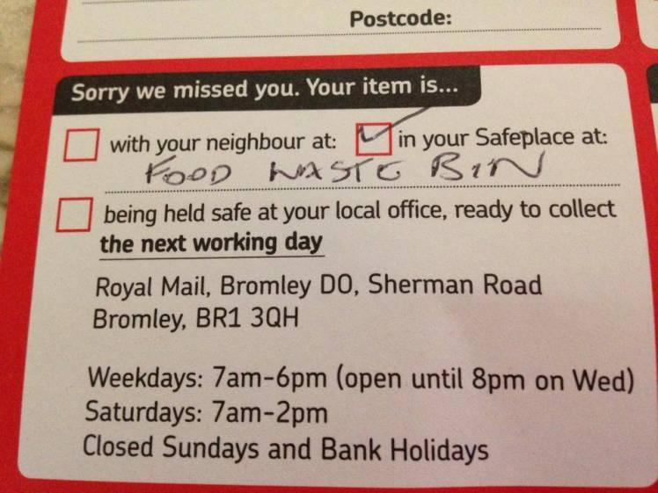
Have you ever…
#2

Slide 3

Q-Trace
#3
Smart Parcel Tracking Service

Slide 4
#4
www.qt.ceykod.com
Tracking code- 100100

Slide 5
#5
Video

Slide 6

#6
ETA – Estimated Time Arrival

Slide 7

#7
COD – Cash On Delivery

Slide 8

#8
DDA – Dynamic Destination Addressing

Slide 9
Business model
#9

Slide 10
#10
Seller
Delivery agents
qTrace
Buyer

Slide 11




Target market
#11
Online sellers
Buyers
Delivery agents

Slide 12

Online sellers
#12
Main target market
API platform – charge a fee
Micro services

Slide 13

Buyers
#13
API platform – charge from the sellers

Slide 14
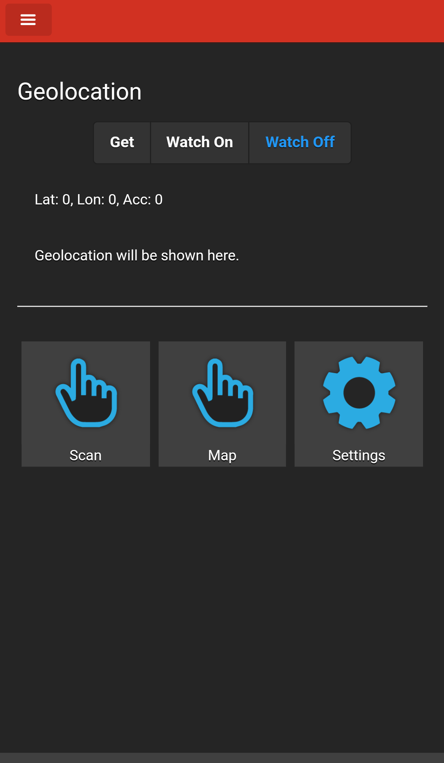
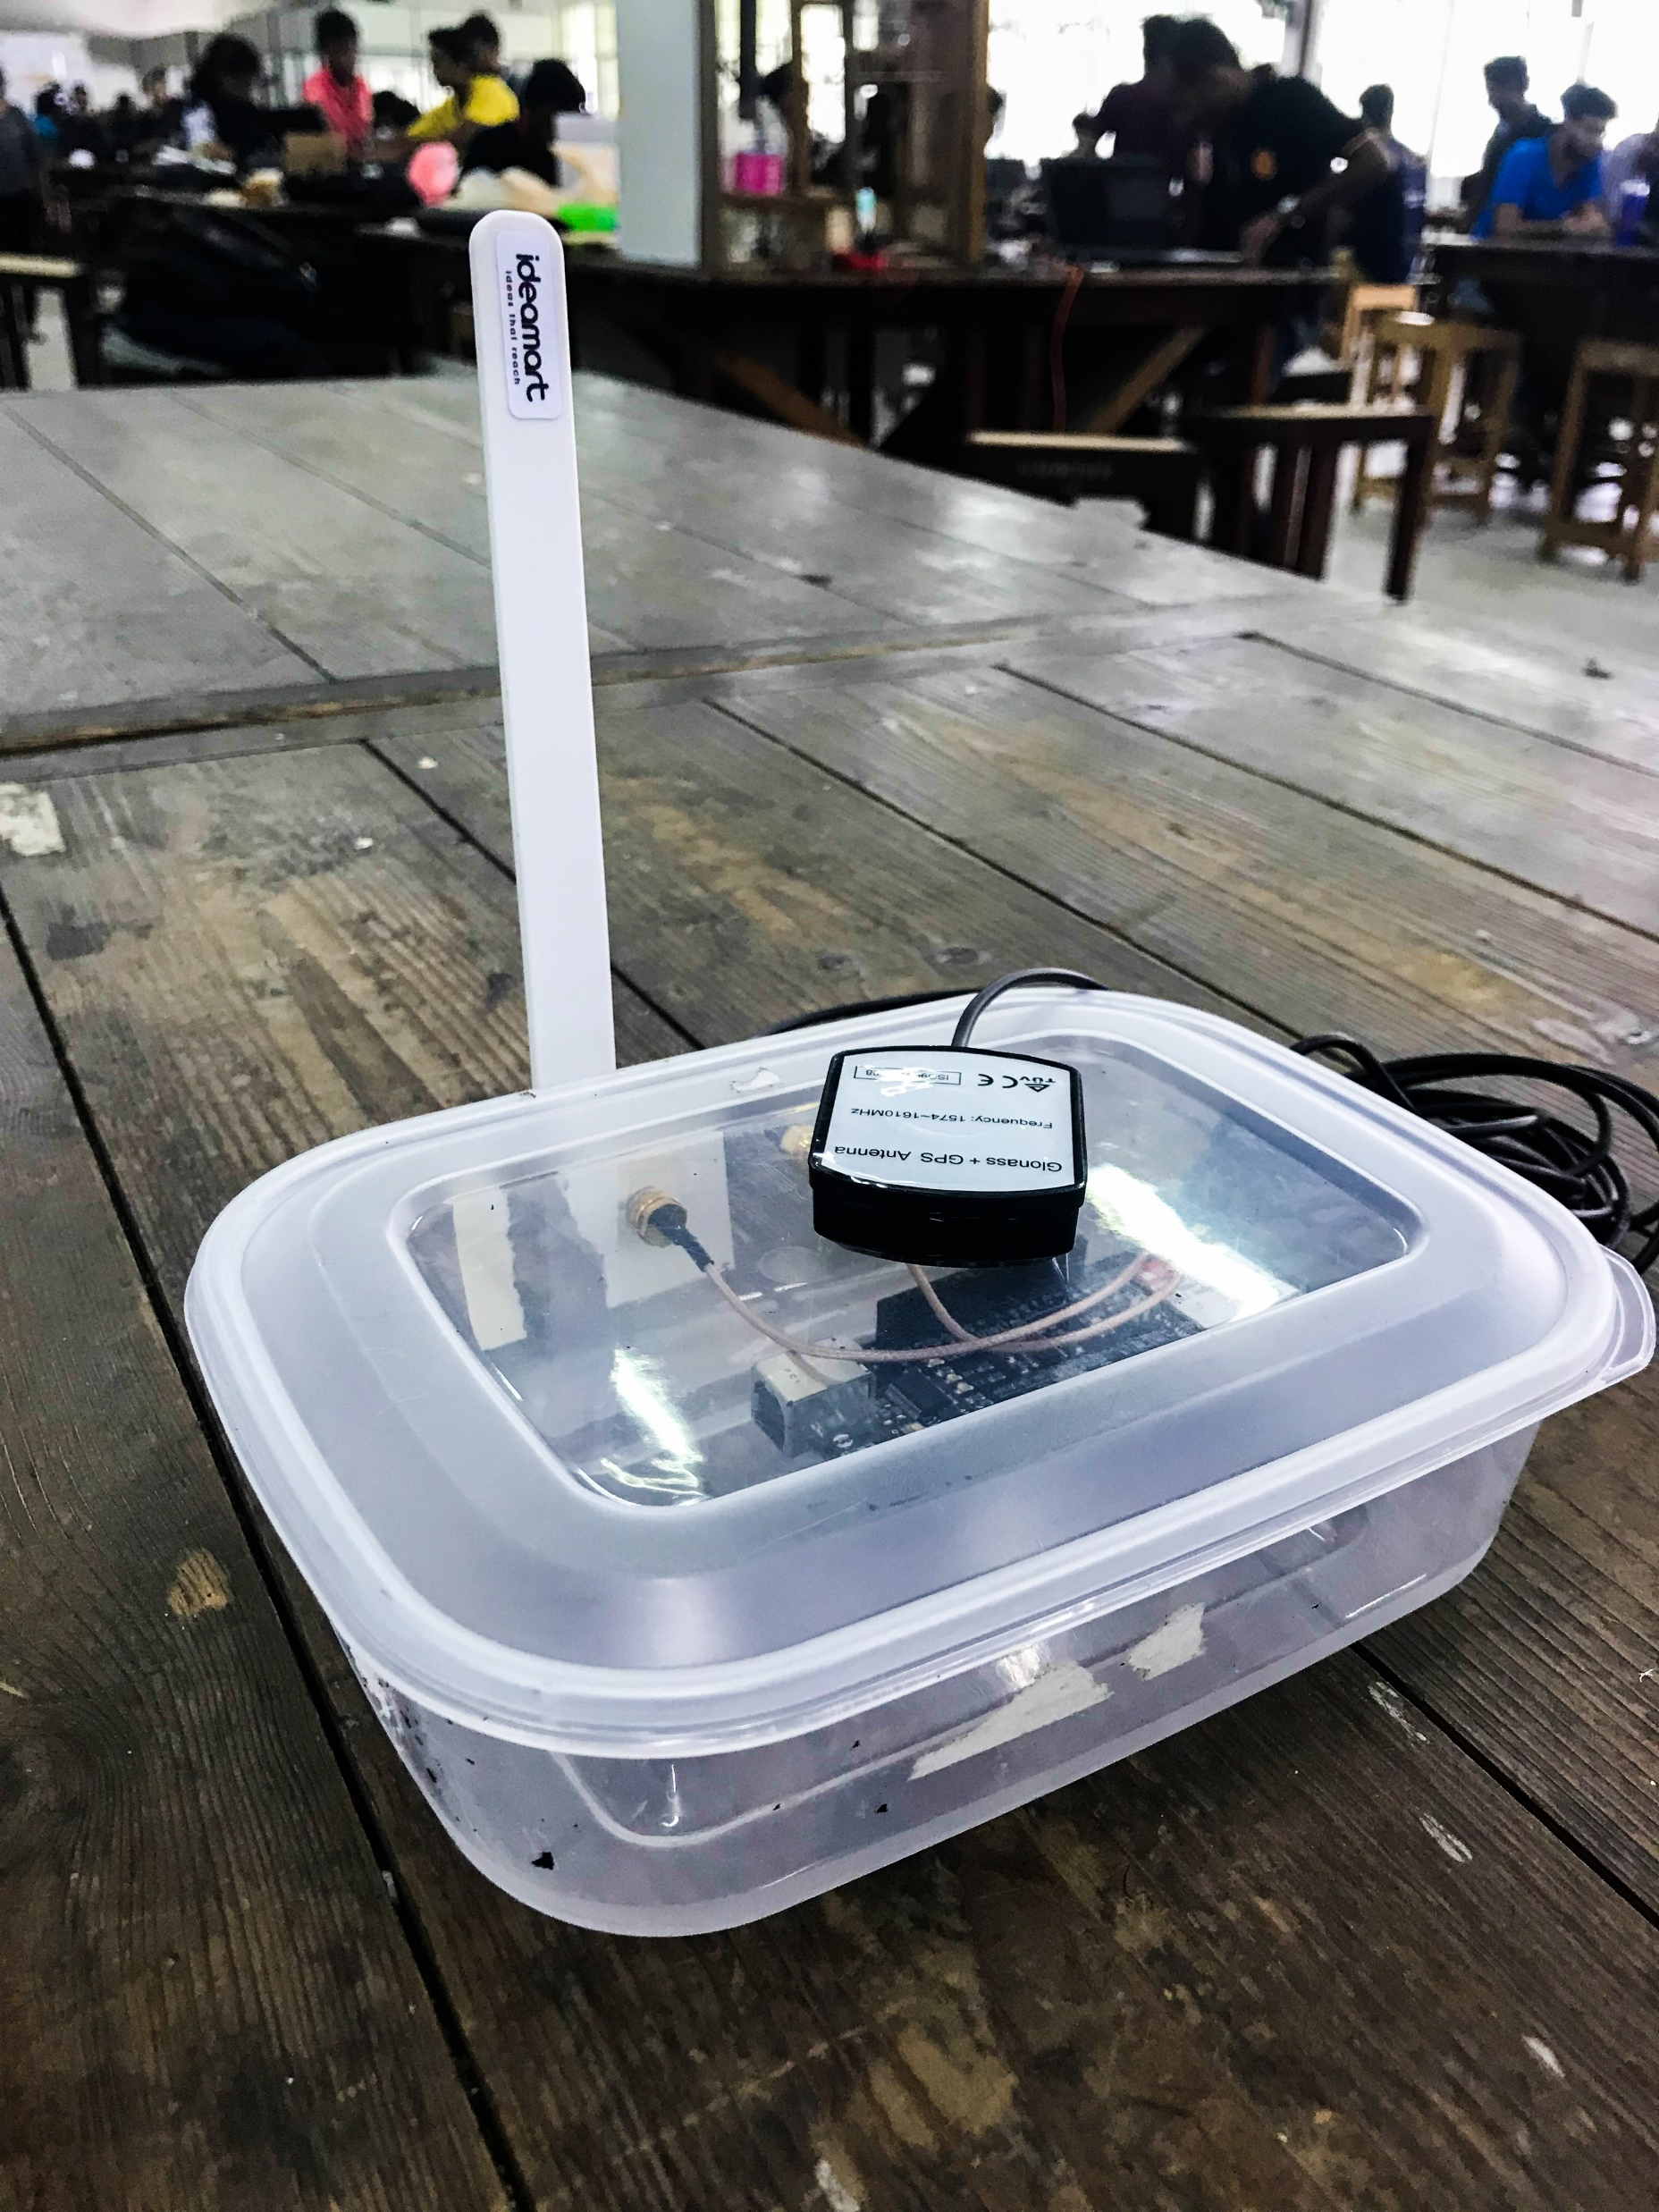
Delivery Agents
#14
Two options
App
GPS tracker

